Slide 1
MotiveGreen
Nidhi Saseendran
200436457
University of Regina

Slide 2

Goal 7: Affordable & clean energy
Website development in WordPress

Slide 3
Scrum dates: June 3 to 5
Project issues:
Not finished on planned time
Using WordPress for first time so took
some time to learn it
Project Changes:
Removed login page(because it is a website
which promote everyone to use renewable energy.
So I thought it will motivate more people to use it.
Project progress feels good:
Finished the planned design
Learned something new(WordPress)
Went deeper to learn about goal 7, got valuable information
Next Up:
Energy efficiency devices and guideline
pages
Status :Green

Slide 4

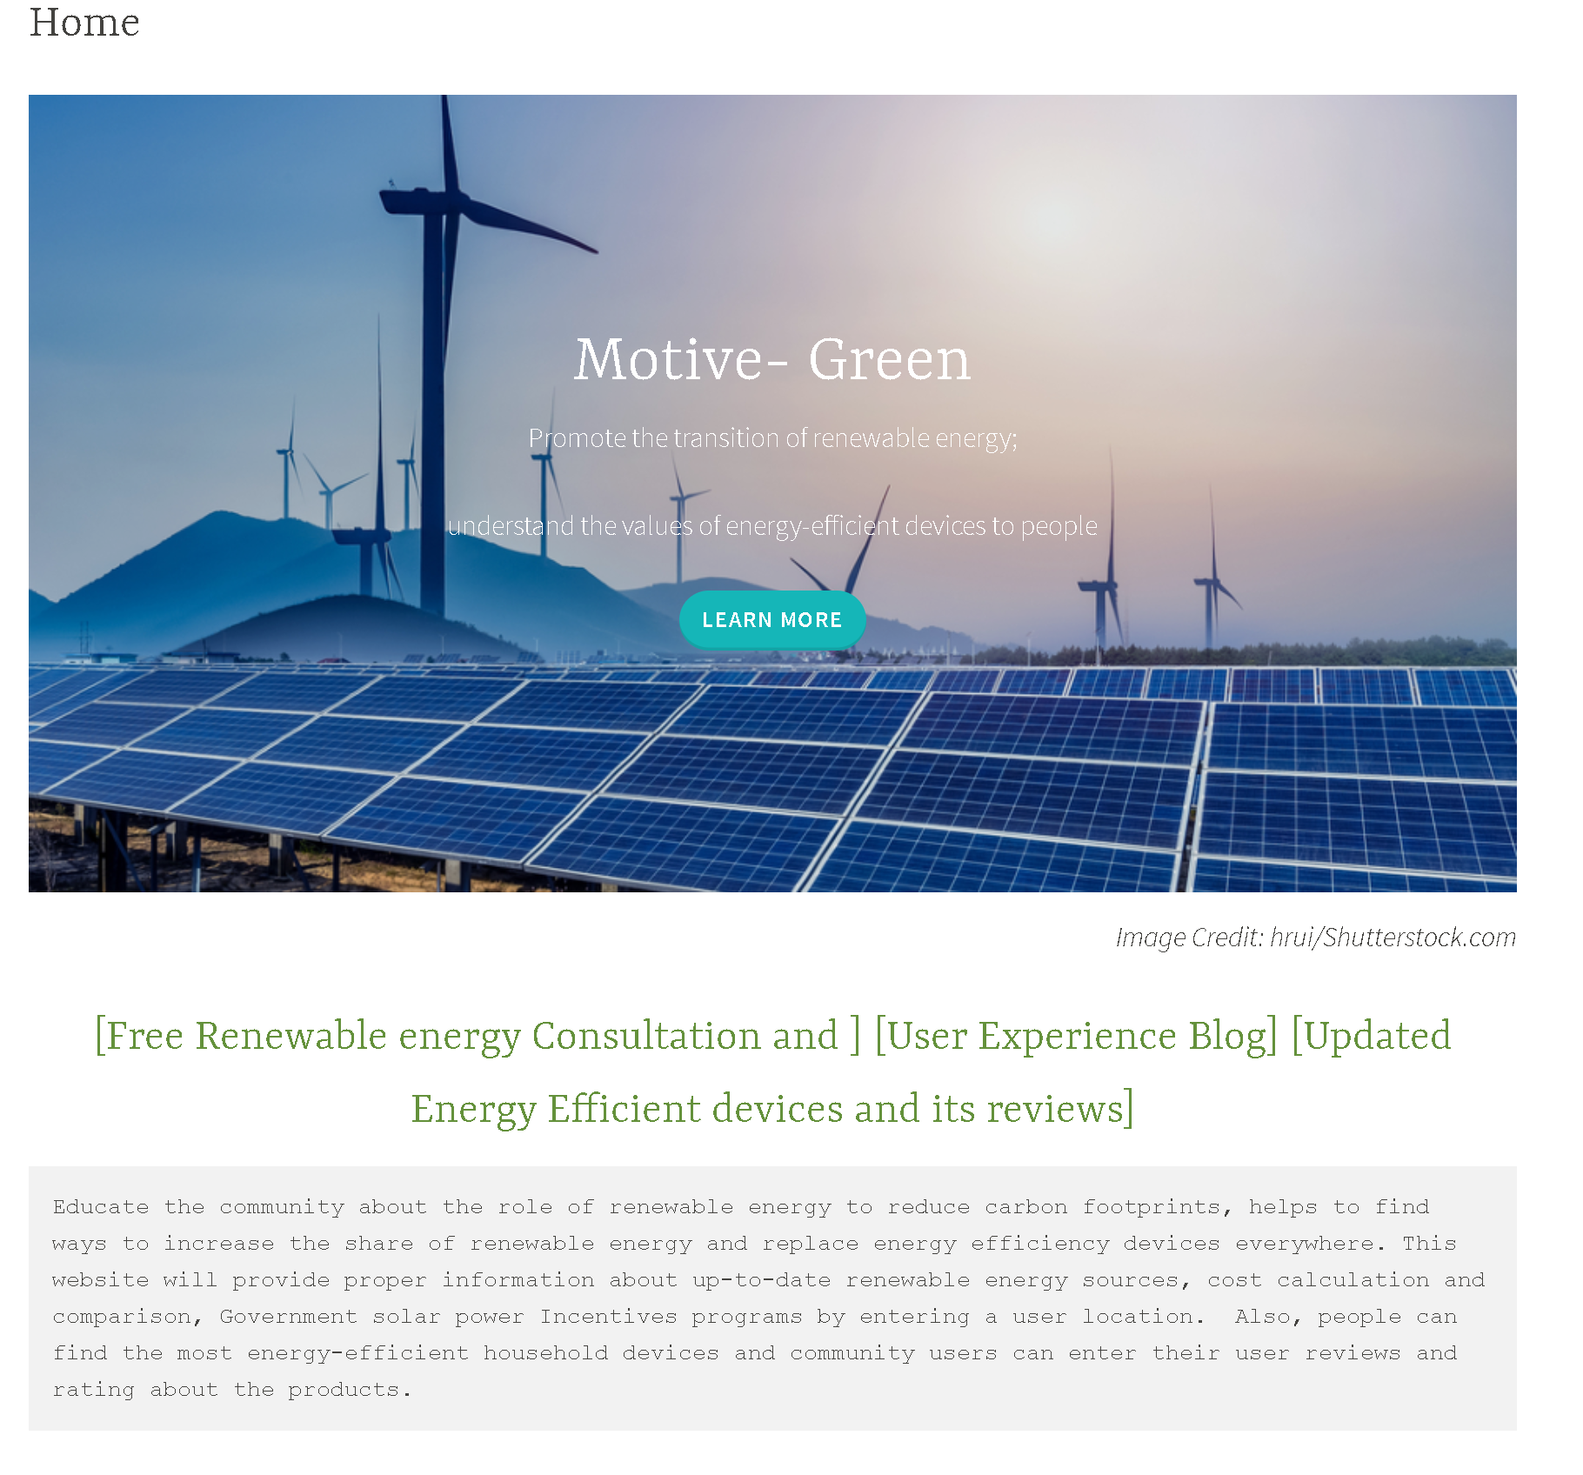
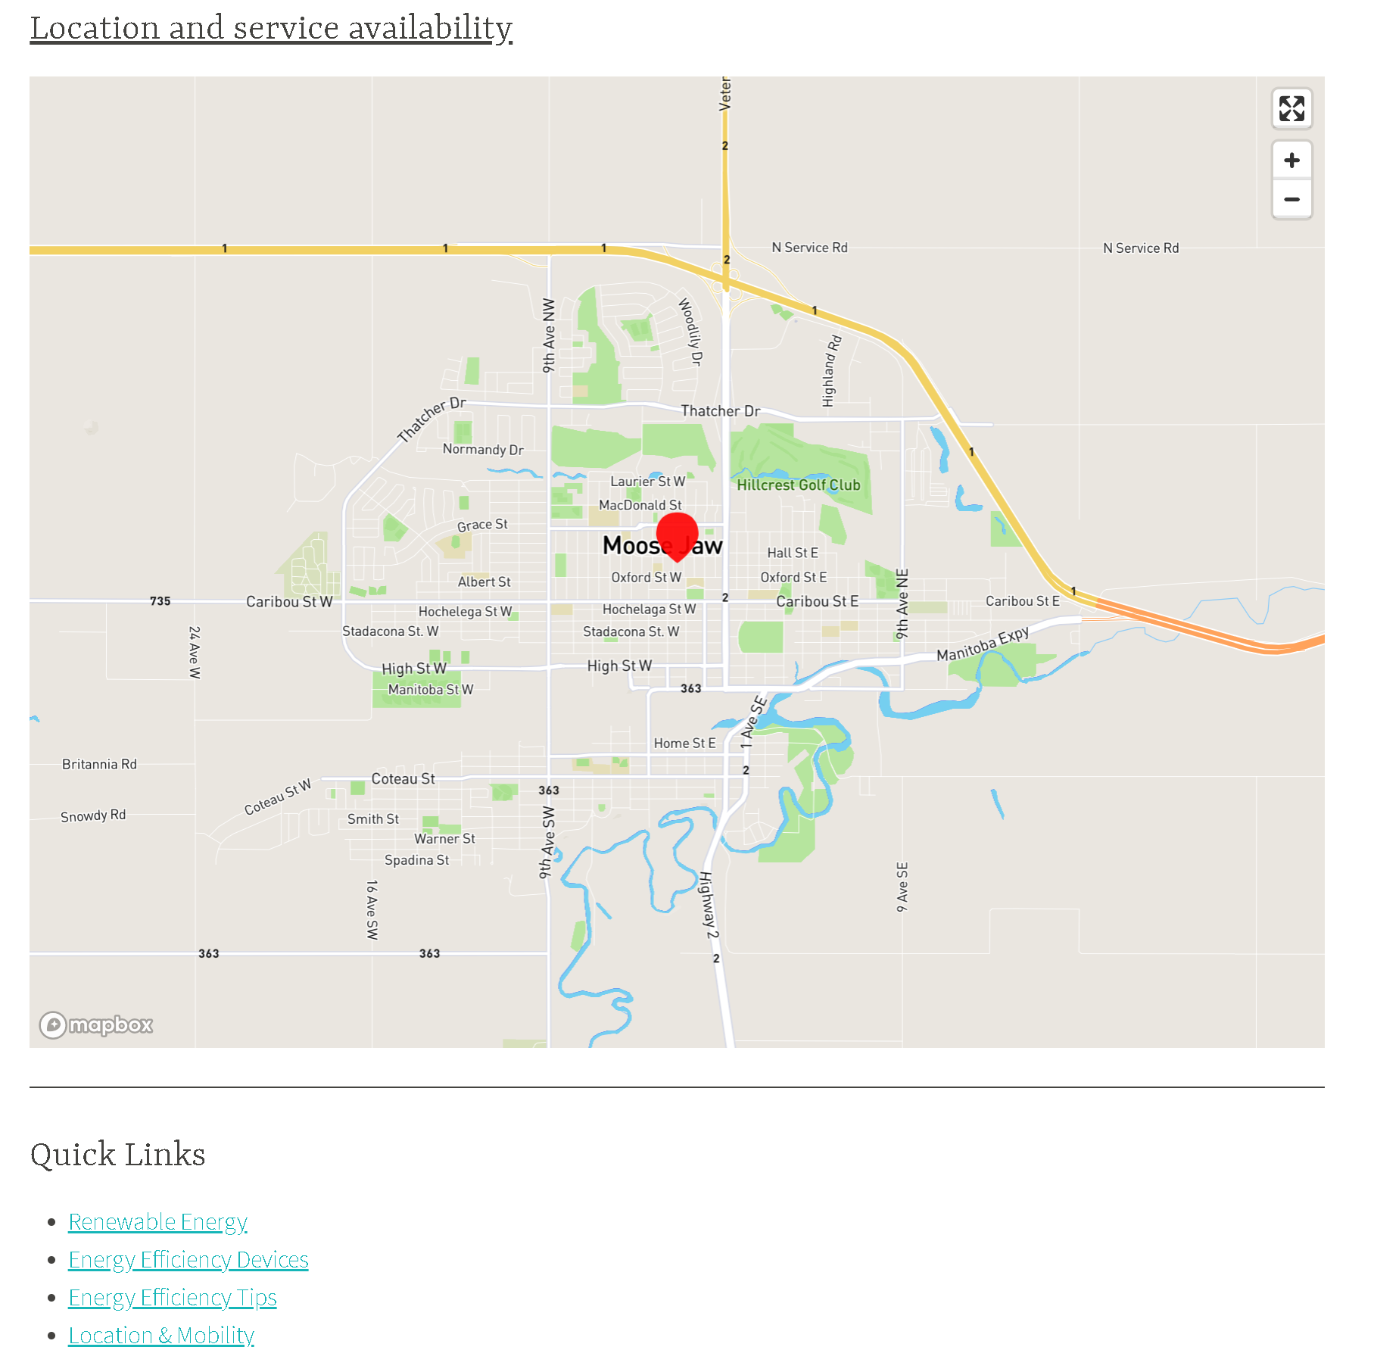
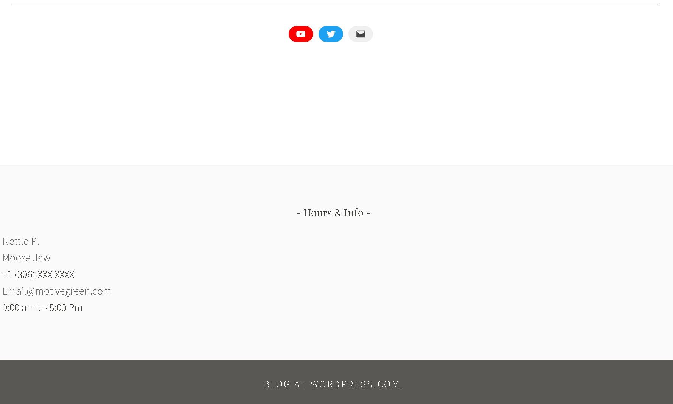
Project Demo
https://motivegreen.wordpress.com/

